Slide 1

Cell Line selector

Slide 2
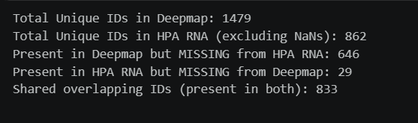
Analysis regarding the HPA RNA and DepMap cell lines
Dataset coverage
DepMap RNA: 1479 unique cell lines
HPA RNA: 1206 unique cell lines
Initial direct mapping using cell-line names showed unexpectedly high missingness.
Initial observation
HPA RNA cell line names were initially matched directly against stripped DepMap cell-line names.
This produced an apparent missingness of approximately 40 to 43%.
We then explored whether using CVCL ID instead of Model ID (ACH ID) would improve the mapping.
The initial analysis appeared to show different missingness depending on the identifier used.
When combined directly using the depmapsample info on the stripped cell line

Slide 3
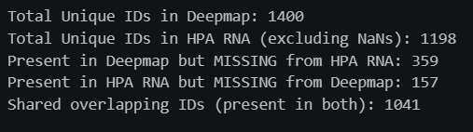
Analysis regarding the HPA RNA and DepMap cell lines
The original discrepancy was caused by the mapping order, not by a fundamental difference between Model ID and CVCL ID.
After correcting the mapping pipeline, the missing count was 359 out of 1479 DepMap cell lines (24–25%).
This primarily reflects the different baseline coverage of the datasets:
  DepMap: 1479 cell lines
  HPA RNA: 1206 cell lines
Therefore, the unmatched cell lines represent differences in dataset coverage, rather than data being lost because of the merge.
Once the mapping is performed correctly, using Model ID or CVCL ID as the link ultimately leads to the same mapped HPA RNA relationships.
Some valid DepMap models do not have a CVCL ID. Using CVCL ID as the primary base would unnecessarily exclude 80 valid cell lines.
When combined using hpa rna cell line description and then on the depmap sample info

Slide 4
Analysis regarding the HPA RNA and DepMap cell lines
Initial approach which resulted in 40% missing data
Depmap
Depmap omnics profile
Depmapinfo
(on the column stripped cell line)
HPA RNA
Final Merge on the Profile ID
To convert it to Profile ID
To convert from cell line names to ACH ID
Final approach which resulted in 25% missing data
Depmap omnics profile
Depmapinfo
(on the column CVCL)
HPA RNA cell line description (merge on Cell line names)
Depmap
HPA RNA
Final Merge on the Profile ID
To convert it to Profile ID
To convert from cell line names to ACH ID
To get the CVCL ID

Slide 5
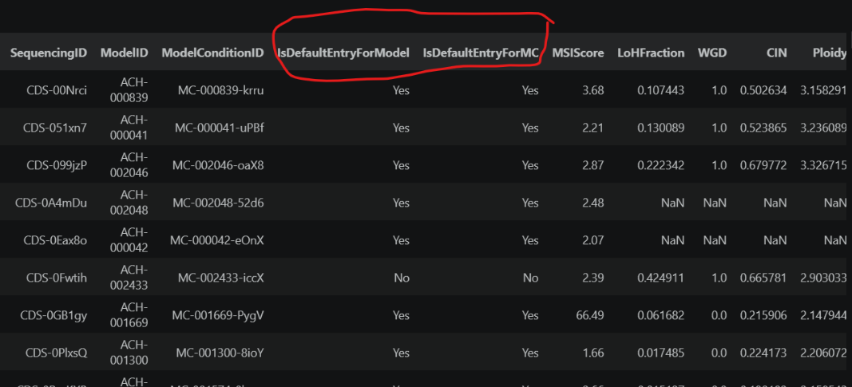
Analysis regarding the HPA RNA and DepMap cell lines
Observation
Identified duplicate Model IDs associated with multiple sequencing or experimental profiles.
Expression values between the duplicate profiles showed very small differences (~0.04) in the investigated cases.
Therefore, retaining either profile would be unlikely to significantly affect the downstream analysis.
Selecting the Most Appropriate Profile
Rather than selecting a duplicate profile arbitrarily, DepMap provides metadata to identify the preferred entry:
  IsDefaultEntryForModel which Identifies the default sequencing profile for a biological model.
  IsDefaultEntryForMC which Identifies the default profile for a specific model condition.
Resolution
The differences between duplicate profiles are minimal.
However, the default-entry metadata provides a systematic and reproducible method for selecting the most appropriate representative profile.
Final approach: Use the DepMap default-entry metadata to select one representative profile for each duplicated Model ID.
This ensures a unique Model ID while avoiding arbitrary duplicate removal.

